Slide 1
Lesson #3
Sentence formation, verbs, tenses...

Slide 2
Things you get on: train, plane, bus, boat. When talking about commercial or public transportation, such as a train or plane, use the preposition on.
Things you get in: taxi, car, truck. When it comes to personal modes of transportation, such as a taxi or a car, use the preposition in.

Slide 3
Homework
Make sentences with these verbs / Forme frases com esses verbos
To be
To do
To have
To say
To go
In any tense and with whatever comes to mind!
Notes:
Questions
Shopping y conv

Slide 4
“To be”
I
You
He, She, Its
We
You
They
am
are
is
are
are
are

Slide 5
REMEMBER
My
Your
His, Her, Its
Our
Your
Their
I
You
He, She, Its
We
You
They
VS

Slide 6
Practice with “To be”
I _____ a woman.
You “are” a tall man.
It “is” a nice day outside! He, she, it IS
He “is” from the United States.
We “are” young.
Why ARE you sad? Why IS she sad? “Why AM I sad?”
The brothers “are” five (5) years old.
Notes:
Do negatives (am not, etc) also
Sabe hacer questions??? verbs??

Slide 7
“To do”
I
You
He, She, Its
We
You
They
do
do
does
do
do
do

Slide 8
Practice with “To do”
I _____ exercise every day.
Why _____ you work?
My son _____ his homework (tarefa escolar).
We _____ our work together (juntos).
You all _____ a good job!
They _____ sports.

Slide 9
“To have”
I
You
He, She, Its
We
You
They
have
have
has
have
have
have

Slide 10
Practice with “To have”
I _____ two siblings.
Do you _____ children?
James _____ a big family.
We _____ a TV at home (em casa).
You all _____ a nice day!
My grandparents _____ eight (8) grandchildren.

Slide 11
“To have to”
Used to express obligation / Usado para expressar obrigação
Examples:
I have to work tomorrow.
You have to study (estudar).
John has to clean the house.

Slide 12
“To say”
I
You
He, She, Its
We
You
They
say
say
says
say
say
say

Slide 13
Practice with “To say”
I _____ “Hello” to my parents.
I do what you _____. (Eu faço o que você diz).
He _____ what he likes.
We say “Goodnight.”
Why do you all _____ mean things? (coisas rudes).
Do what they _____!
Notes:
Fewer bc not as many examples

Slide 14
“To go”
I
You
He, She, Its
We
You
They
go
go
goes
go
go
go

Slide 15
Practice with “To go”
I _____ to school in Medford.
(You) Go away!
He _____ to work on Monday.
We _____ to the park (parque) to play soccer.
When do you all _____?
Emma and Grace _____ to the store.

Slide 16
Tenses

Slide 17
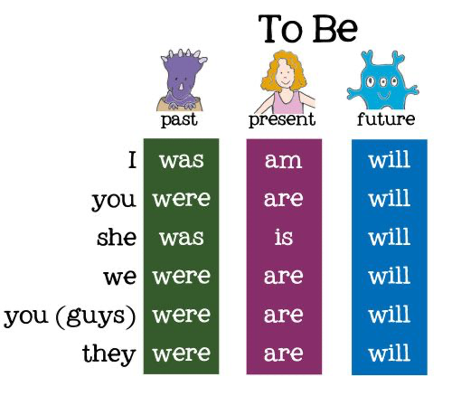
“To be”

Slide 18
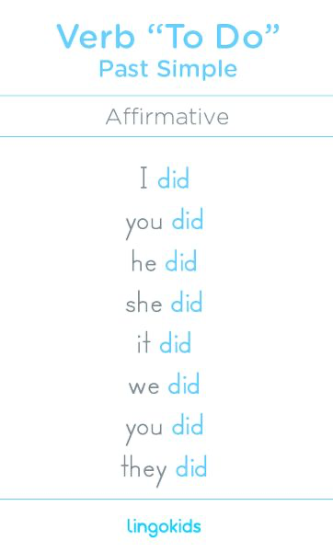
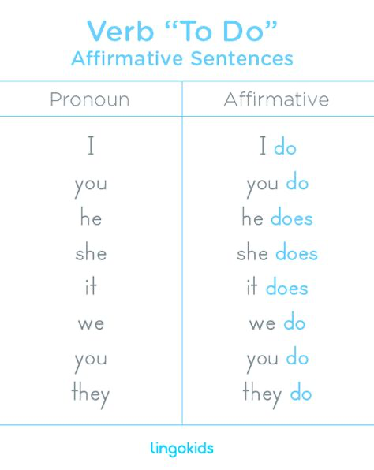
“To do” (and go)
Future
Pronoun + will + do

Slide 19
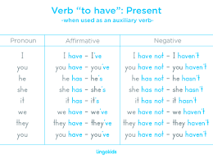
“To have”
Notes:
past??/

Slide 20
“To say”
You practice!

Slide 21
Homework
Make sentences with these verbs / Forme frases com esses verbos
To be
To do
To have
To say
To go
In the PAST and FUTURE!

Slide 22
Question
What do you need help with?
Continuous
Past participles (have/had + participle)
Have gone
Negatives
Questions

